Slide 1

Comparing
Technical Indicators
CCI
By Sarah

Slide 2

Objective
The objective of this presentation is to evaluate and compare the performance of two trading strategies that combine popular indicators with the Commodity Channel Index (CCI).
Specifically, we will examine the effectiveness of combining the Exponential Moving Average (EMA) with CCI and the Moving Average Convergence Divergence (MACD) with CCI.
The aim is to determine which strategy demonstrates superior performance in identifying potential trend reversals, generating accurate trading signals, and maximizing profit potential.
By analyzing historical data and key performance metrics, we seek to provide insights into the effectiveness of these combined strategies and their potential value in enhancing trading decisions.

Slide 3
Let's begin by discussing the strategy that combines the Exponential Moving Average (EMA) with the Relative Strength Index (RSI).
EMA: The EMA is a trend-following indicator that provides a smoothed line representing the average price over a selected time period. By combining the EMA with RSI, we can benefit from the EMA's ability to identify trends while leveraging the RSI's overbought and oversold conditions as potential reversal points.
CCI: The Commodity Channel Index (CCI) is a versatile indicator that measures the current price level relative to its average price over a specified period. It is commonly used to identify overbought and oversold conditions, as well as potential trend reversals in financial markets.
We will analyze historical price data and evaluate the success rate, average profitability, and risk-to-reward ratio of this combined strategy to determine its effectiveness.
Overview of the EMA and CCI Combination Strategy

Slide 4

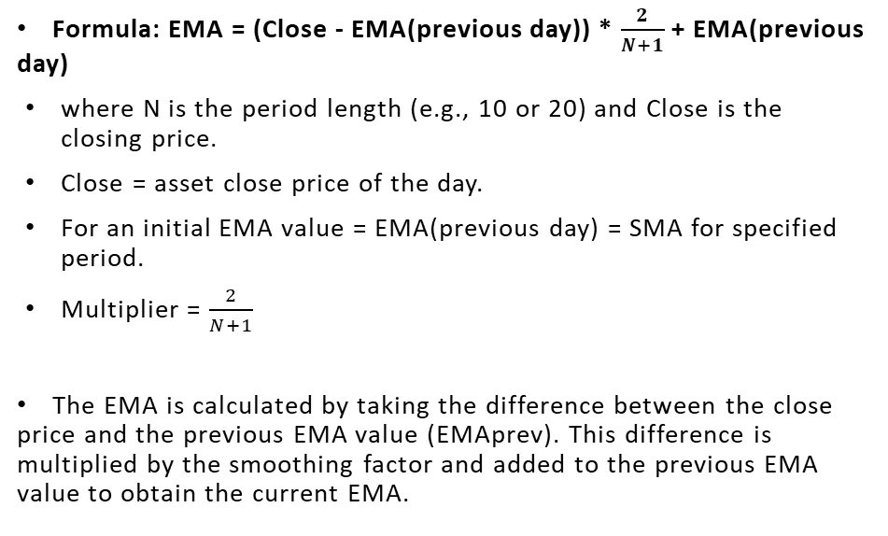
EMA formula

Slide 5
CCI Formula
CCI Formula = (Typical Price - MA)/ 0.015 x Mean Deviation

Slide 6




Defining First Entry and Exit Condition
Buy Entry: When the 10 period EMA is > 20 period EMA
Exit: The CCI is <= -100.
Sell Entry: When the 10 period EMA is < 20 period EMA
Exit: The CCI is >= 100.

Slide 7
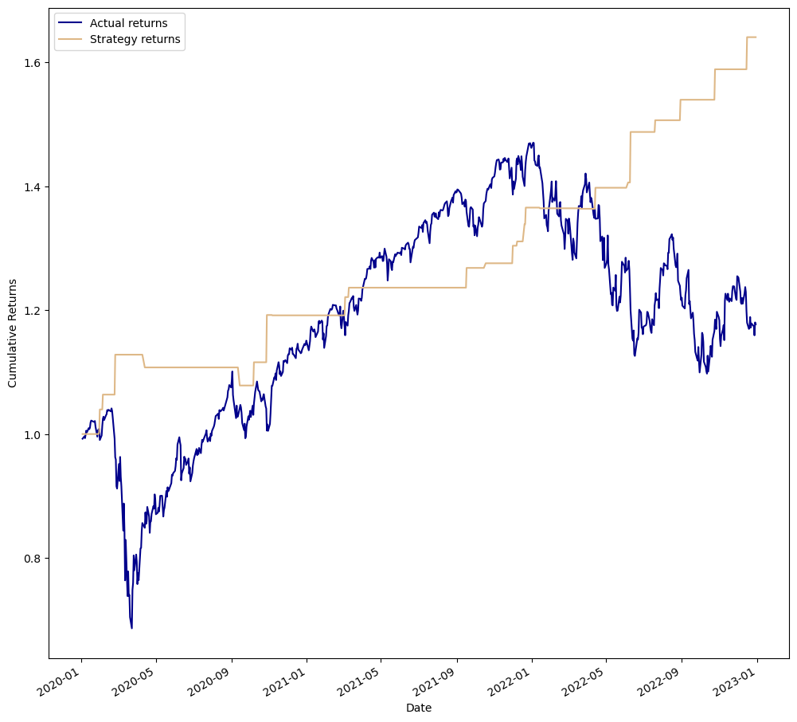
Backtest Result

Slide 8
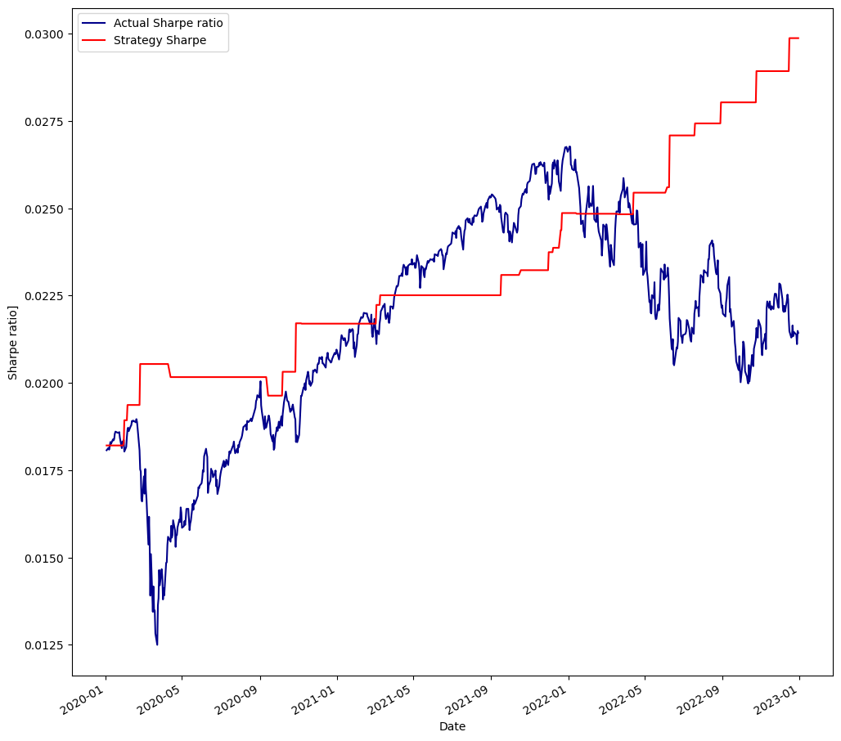
Sharpe Ratio Result

Slide 9





Defining Second Entry and Exit Condition
Buy Entry: When the 10 period EMA is > 20 period EMA
Exit: The CCI is <= -50.
Sell Entry: When the 10 period EMA is < 20 period EMA
Exit: The RSI is >= 50.

Slide 10
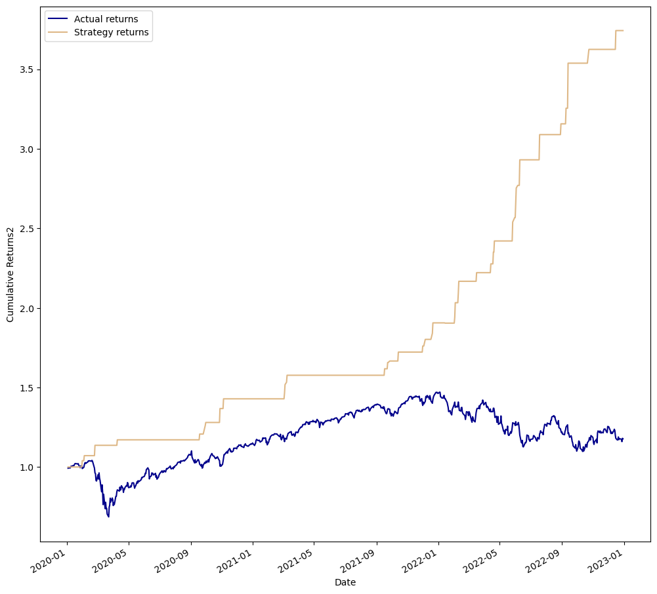
Backtest Result

Slide 11
Sharpe Ratio
Result

Slide 12

MACD Formula
Moving Average Convergence Divergence (MACD): MACD is a versatile indicator that combines trend-following and momentum characteristics. It consists of two lines: the MACD line, which represents the difference between two moving averages, and the signal line, which is a moving average of the MACD line. The MACD line crossing above or below the signal line is often considered a potential reversal signal.
It is calculated as follows:
MACD=12-Period EMA − 26-Period EMA
Signal line = 9- period EMA of MACD Line
Histogram = MACD line - Signal line

Slide 13
Defining Entry and Exit Condition for MACD & CCI
Buy Entry: MACD line > Signal line.
Exit: The CCI is <= -100.
Sell Entry: MACD line < Signal line
Exit: The CCI is >= 100.

Slide 14

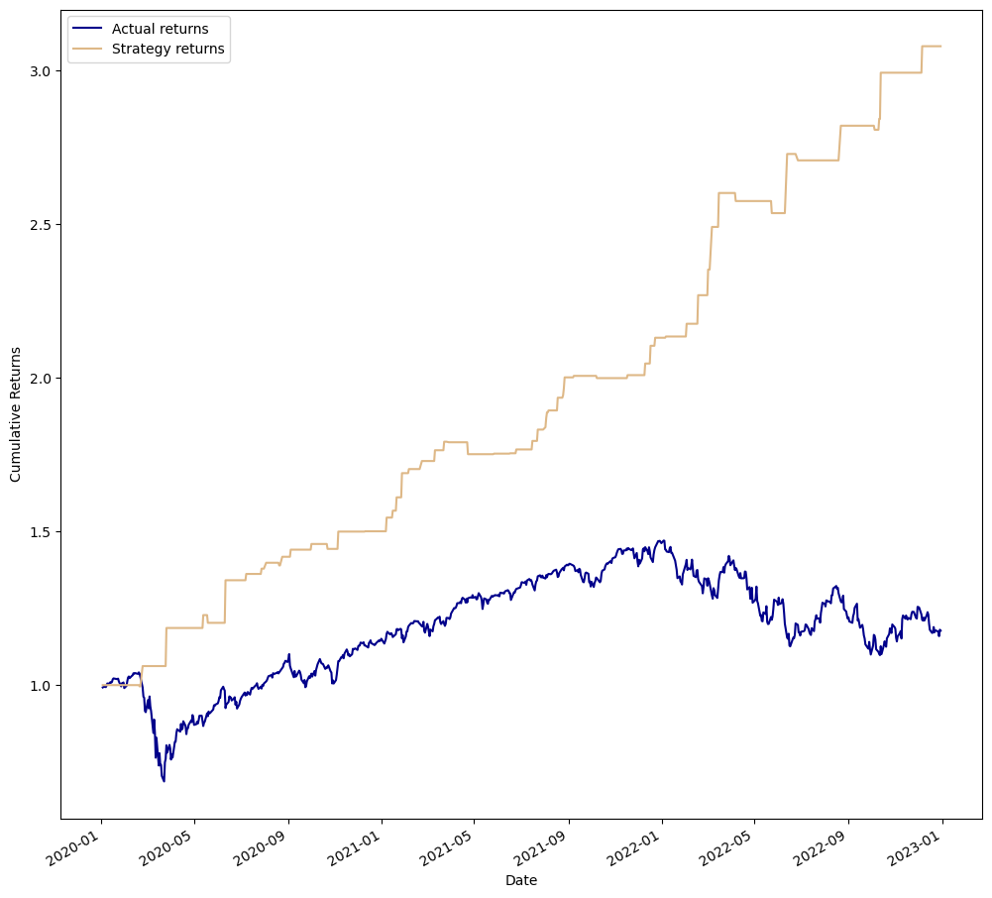
Backtest Result

Slide 15
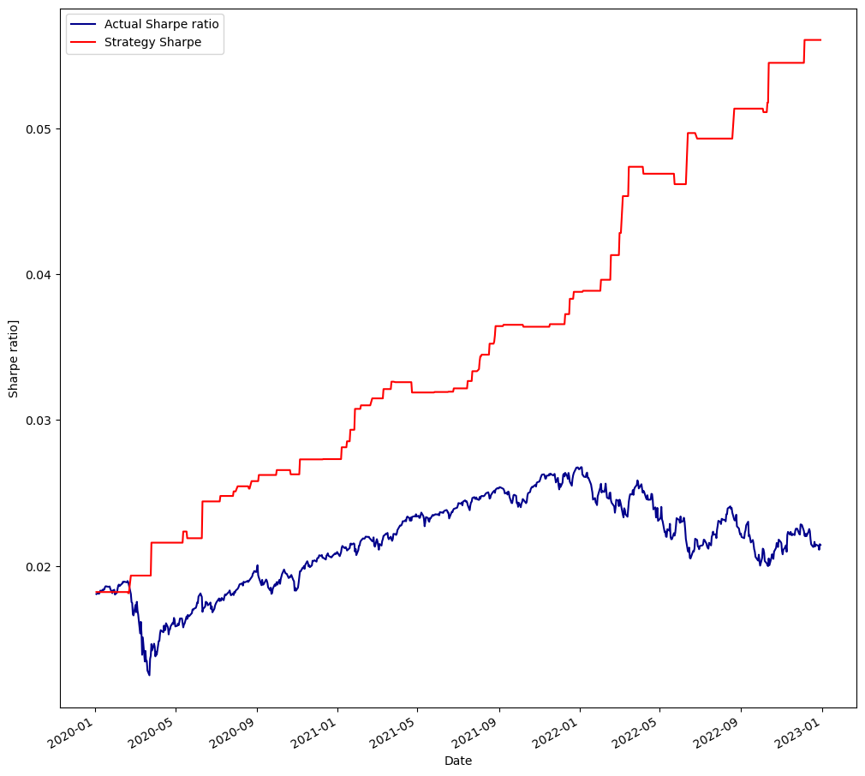
Sharpe Ratio Result

Slide 16

Defining Second Entry and Exit Condition MACD & CCI
Buy Entry: MACD line > Signal line.
Exit: The CCI is <= -50.
Sell Entry: MACD line < Signal line
Exit: The CCI is >= 50.

Slide 17

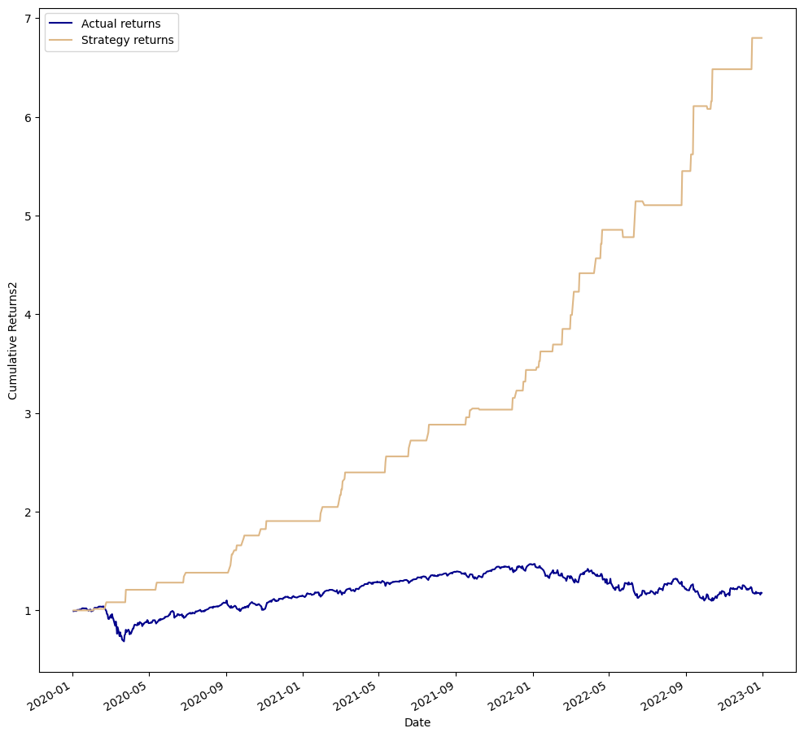
Backtest Result

Slide 18
Sharpe Ratio Result

Slide 19
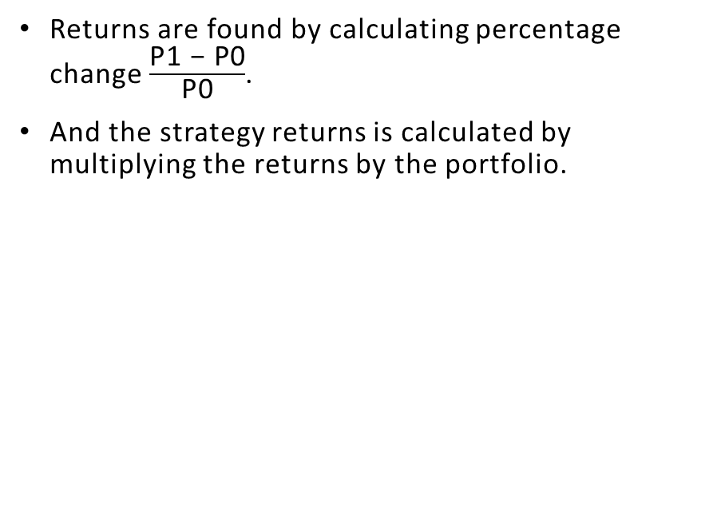
Returns Formula

Slide 20
Based on the analysis conducted with two different conditions, it has been found that the MACD strategy outperformed the EMA strategy in terms of profitability when combined with the Commodity Channel Index (CCI).
Under the first condition, where the CCI benchmarks of -100 and 100 were used as exit conditions, the EMA strategy produced returns of 1.6 times the initial investment, while the MACD strategy demonstrated stronger performance with returns of 3.0 times the initial investment. This indicates that the MACD strategy was more effective in identifying potential trend reversals and generating profitable trading signals when using the CCI benchmarks as exit conditions.
Similarly, under the second condition, where the CCI benchmarks of -50 and 50 were used as exit conditions for selling and buying respectively, the EMA strategy yielded returns of 3.5 times the initial investment, while the MACD strategy exhibited superior performance with returns of 7.0 times the initial investment. This highlights the MACD’s ability to capture larger price movements and generate higher profits during trend reversals indicated by the CCI.
Findings

Slide 21
These findings suggest that the combination of the MACD and CCI indicators performed better than the EMA and CCI combination strategy. The MACD strategy demonstrated greater consistency and profitability in identifying potential reversals and generating profitable trading signals when utilizing the specified CCI benchmarks.
It's important to note that trading strategies should be evaluated regularly, and adjustments should be made as market conditions evolve. Continued monitoring and analysis are necessary to ensure the strategies remain robust and aligned with personal goals and market dynamics.
In summary, based on the analysis conducted, the MACD and CCI combination strategy demonstrated superior performance compared to the EMA and CCI combination strategy. The MACD strategy exhibited better profitability and consistency in identifying potential trend reversals and generating profitable trading signals when utilizing specific CCI benchmarks as exit conditions.
Conclusion

